Slide 2
-
WELCOME
Nancy Bolton
Assistant County Administrator
Palm Beach County

Slide 3
-
WELCOME
Mack Bernard
County Commissioner
Palm Beach County (District 7)

Slide 4
-
OPENING REMARKS
James Green
Director
PBC Community Services Department

Slide 5
-
TEN-YEAR PLAN ACHIEVEMENTS
& SYSTEM ENHANCEMENTS
Georgiana Devine
Homeless Program & Contract Manager PBC Community Services Dept. – Human & Veteran Services Division

Slide 6
BACKGROUND
Developed after obtaining input through community forums
Approved by the BCC September 2008
7 Goals with 63 Action Steps
Focused on homeless service delivery system
Achievements of goals & Action Steps

Slide 7
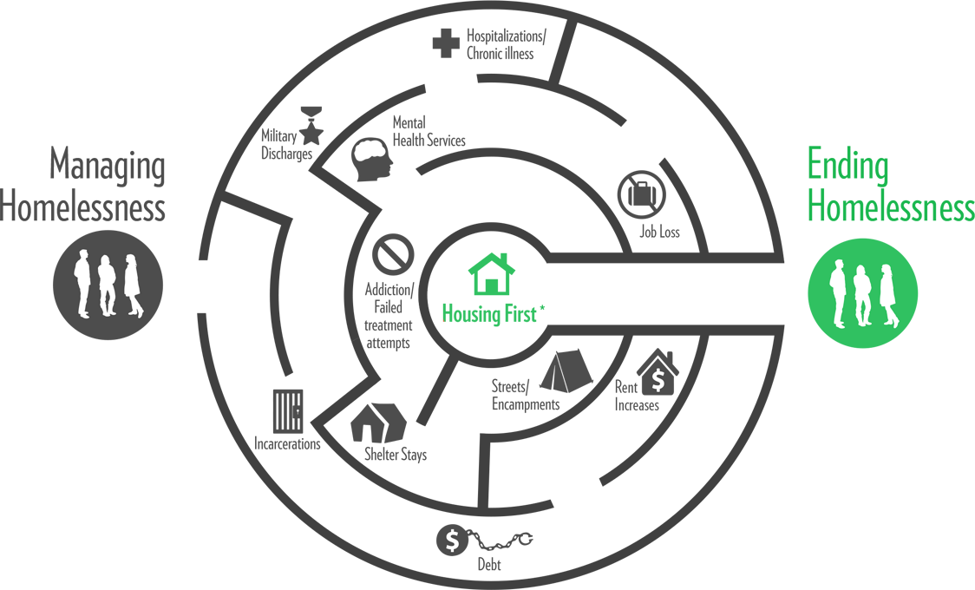
SHARED GOAL OF ENDING HOMELESSNESS

Slide 8
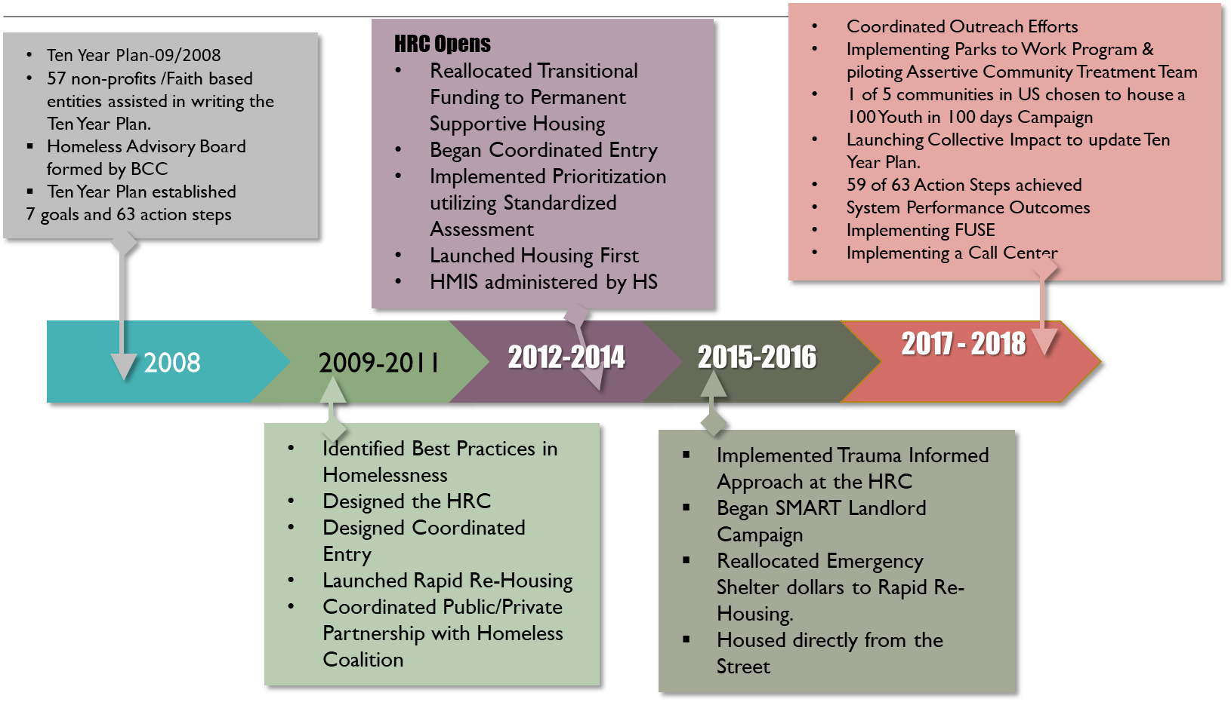
TEN YEAR PLAN AND SYSTEM ENHANCEMENTS

Slide 9
TEN YEAR PLAN LESSONS
Data, Data, Data (Dashboards, Mapping, Performance Measures)
Be creative and Resourceful
Cross system collaboration i.e. public welfare, justice, behavioral health, health care
Sufficient Affordable Housing remains a barrier
Community effort requiring public, private, business and faith-based collaboration

Slide 10
-
INSIGHTS ON COLLECTIVE IMPACT
HOUSING NEED & FUNDING
Regina Cannon
Senior Program Manager, CSH

Slide 11
-
LEADING THE WAY HOME:
HOUSING PLAN FOR PBC
Wendy Tippett
Director PBC Community Services Dept. – Human & Veteran Services Division

Slide 12
STRATEGIES FOR HOUSING
How did PBC quantify the number of units needed?
1,356
Units of Permanent Affordable Housing
Units of Permanent Supportive Housing
2,163
2017
CSH Report

Slide 13
STRATEGIES FOR HOUSING
Agency | Current Development Underway
PBC Housing Authority | 144 units Covenant Villas(Belle Glade) 49 units South Bay Villas
West Palm Housing Authority | 99 units for Seniors (WPB) 120 units Multi-Family (WPB) 9 units Public Housing (WPB) 12 Single Family (home ownership)(WPB)
Collaboration PBCHA & WPBHA | 36 Townhomes
Goodwill Industries | 6 units ELI (Extremely low income) - Singles Developmental Disabilities
Adopt-A-Family | 12 units - 50% or less of Area Median Income for Families
TOTAL UNITS UNDER DEVELOPMENT: 475 RENTAL AND 12 HOMEOWNERSHIP

Slide 14
STRATEGIES FOR HOUSING
Increasing Housing Supply in PBC:
Hire a full time employee that will focus solely on partnerships and funding opportunities
Work with Developers and Florida Housing Finance to establish set-aside partnerships as it relates to Coordinated Entry List
Sales Tax Revenue = purchase of housing for targeted population
Work jointly with Department of Housing and Economic Development to produce Micro-Units and Container Housing
Allocation of local funding to prioritize supportive services
Partner with Housing Authorities to secure subsidized units

Slide 15
STRATEGIES FOR HOUSING
Apply for a new PSH HUD housing project annually and reallocate low performing projects to high performing agencies
Development of Homeless Resource Centers in the Southern and Western areas of PBC
Faith-Based Support to provide host homes, employment services and “adoption” of one homeless family or person for a period of 12 months
Development of Youth (ages 16 to 24) Drop-In Centers and Housing Models

Slide 16
-
FULL ENGAGEMENT:
HARNESSING OUR COLLECTIVE EFFORTS
James Green
Director
PBC Community Services Department

Slide 17
-
SHARED GOALS & TIMELINES
FOR TEN-YEAR PLAN
Taruna Malhotra
Assistant Director PBC Community Services Department

Slide 18
-

Slide 19
OUR SHARED GOALS
BY DECEMBER 2018
108
(house 7 a month)
100
(house 6 a month)
Chronic Homeless
Veterans
81
(house 5 a month)
100
(house by Nov. 8 2017)
Families
Youth

Slide 20
ENDING CHRONIC & VETERAN HOMELESSNESS
Utilize Housing First & Rapid Re Housing models
Identify funding for Intensive Wrap-Around Services funded in current PSH programs
Utilize Medicaid for support services in PSH
Increase resources for outreach teams & Housing Specialists
Reallocate existing CoC Supportive Services funding to leasing to increase PSH beds
Increase capacity & funding for clinical case management

Slide 21
STEPS TO ENDING VETERAN & CHRONIC HOMELESSNESS
Utilize Acuity Criteria to ensure most vulnerable are housed in PSH i.e. longest time homeless, FUSE, Veteran, DV, highest barriers
1
Coordinate Outreach to prevent duplication
2
Utilize low barrier programs & RRH when PSH not available
3
Identify Section 8 Vouchers to move individuals from PSH that no longer require intensive supportive services
4
Identify landlords to quickly provide housing
5

Slide 22
ENDING YOUTH HOMELESSNESS BY
NOVEMBER 8, 2017
Effectively
identify & engage youth at risk, or experiencing homelessness
Connect
youth with trauma-informed, culturally appropriate, & developmentally age-appropriate interventions
Establish Core Outcomes for Youth
Stabilize housing
Create permanent connections
Create employment/education opportunities
Focus on emotional/social well-being

Slide 23
ENDING YOUTH HOMELESSNESS BY NOVEMBER 8,2017

Slide 24
CURRENT EFFORTS
Chosen to participate in 100 Day 100 Youth Housing Challenge
Applying for Youth Demonstration Grant in September 2017
Applied for Youth Outreach Grant to create a drop-in center and increase community outreach

Slide 25
ENDING FAMILY HOMELESSNESS BY DECEMBER 2018

Slide 26
ENDING FAMILY HOMELESSNESS BY DECEMBER 2018
Emergency Assistance -helping families still in their own housing, but “at risk” losing it because they are behind on their rent, utilities, or other expenses
Diversion -helping families that may have lost their housing identify resources other than ES
Emergency Shelters -short-term emergency placement for families with no other resources
Supportive Housing –housing with extensive wrap around services to address barriers to maintaining housing

Slide 27
GOALS FOR ENDING FAMILY HOMELESSNESS
House 81 Family Households from By Name List:
Utilize Call Center to coordinate resources & collaborate with all partners
Identify Section 8 Vouchers to move individuals from PSH that no longer require extensive supportive services
Identify additional funding for Case Management and RRH costs
Identify landlords to ensure rapid housing placement

Slide 28
SHARED GOALS- LEADING THE WAY HOME
Community Providers, Faith Based Organizations, Businesses and Funders Support shared goals and models
Join efforts targeting the four goals to house Chronic, Veterans, Youth & Families

Slide 29
Breakout Sessions
SESSION I: The Path Forward: Structure for Continuous Engagement
Daniel Ramos, Operation Supervisor PBC Community Services Dept. – Human & Veteran Services Division
SESSION II: Building Opportunities for Affordable Housing Development
Susan Pourciau, CFO & Director Homeless Training and Technical Assistance, Florida Housing Coalition
Sherry Howard, Deputy Director Department of Housing and Economic Sustainability
David Brandt, Executive Director Housing Finance Authority of Palm Beach County

Slide 30
-
Next Steps & Call to Action
James Green
Director
PBC Community Services Department

