Slide 1



2020 Point-in-Time Count
Homeless & Housing Alliance
Palm Beach County Community Services

Slide 2
Point-in-Time & Housing Inventory Count
The Point-in-Time (PIT) count is a count of sheltered and unsheltered people experiencing homelessness on a single night in January.
Department of Housing and Urban Development (HUD) requires that Continuums of Care (CoC) conduct an annual count of people experiencing homelessness who are sheltered in emergency shelter, transitional housing, and safe havens on a single night.
The Housing Inventory Count (HIC) is a point-in-time inventory of provider programs within a CoC that provides beds and units dedicated to serve people experiencing homelessness, categorized by five program types: Emergency Shelter, Transitional Housing, Rapid Re-housing, Safe Haven, and Permanent Supportive Housing.
Palm Beach County PIT Count took place from noon on Thursday January 23,2020 to noon on Friday January 24, 2020.
Palm Beach County employees and volunteers divided into groups to cover all of PBC (geographically) to count individuals experiencing homelessness within the 24-hour period.

Slide 3

PIT – Sheltered Count
480 persons sheltered
361 persons in Emergency Shelter
119 persons in Transitional Housing
Notes:
This can also be on the same page of the GIS map. Just add icons to the shelters.

Slide 4
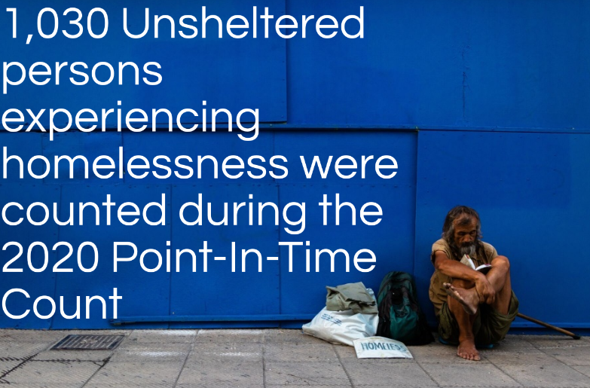
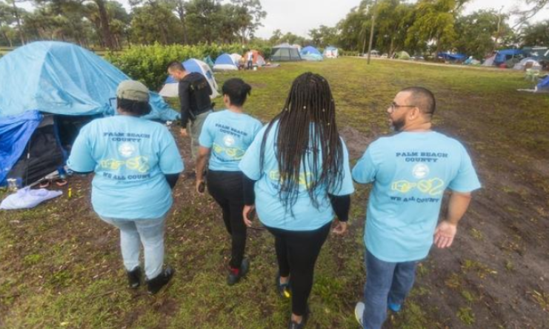
PIT – Unsheltered Count
1,030 Unsheltered persons experiencing homelessness were counted during the PIT Count.
849 Homeless surveys conducted
181 Observations conducted
Notes:
This can be on the same slide as the GIS map. You can add a pin drop or icon for the shelter locations as well.

Slide 5
2020 PIT Count – Sheltered/Unsheltered
The chart below shows the amount of homeless people counted in sheltered/unsheltered locations.

Slide 6
PIT Count- Unsheltered vs Sheltered
The chart shows how many "Unsheltered” vs “Sheltered” persons counted during the PIT Count

Slide 7
2020 PIT Count – Household Type
The chart shows how many “Single Persons” vs “Families” were surveyed in the last four PIT Counts.

Slide 8
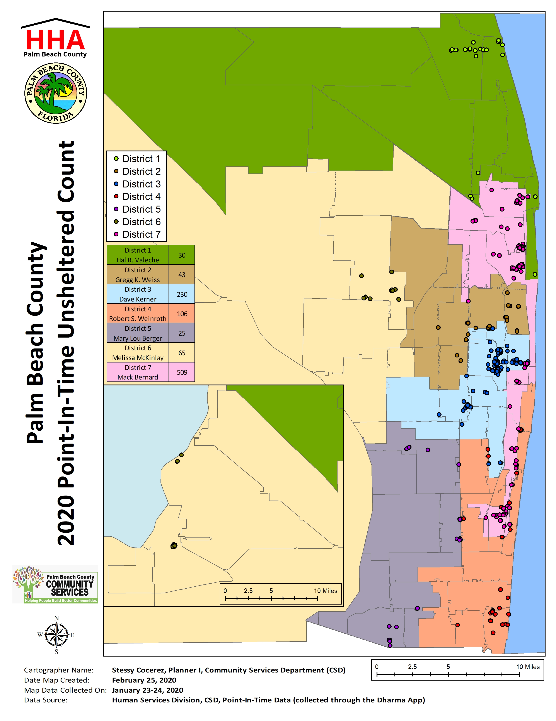
The highest number of unsheltered individuals were counted in District 7 with a count of 509.
District 3 had the second highest number with an unsheltered count of 230.
District 4 had the third highest number with a count of 106 unsheltered individuals.
Less than 100 individuals were counted in each of the remaining districts.
Notes:
509 unsheltered individuals were counted in District Seven. 230 individuals were counted in District Three. 106 unsheltered individuals were counted in District Four. Less than 100 individuals were counted in each of the remaining districts.

Slide 9
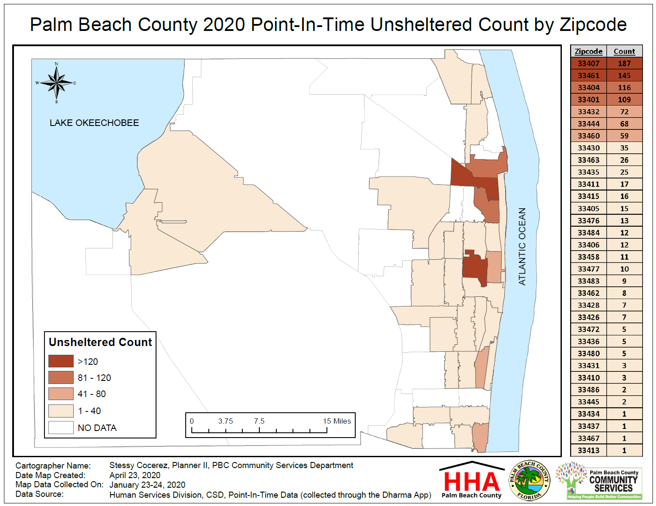
The greatest number of homeless individuals were counted in the West Palm Beach and Lake Worth Beach areas.
Delray Beach and Boca the third highest number of unsheltered homeless individuals.

Slide 10
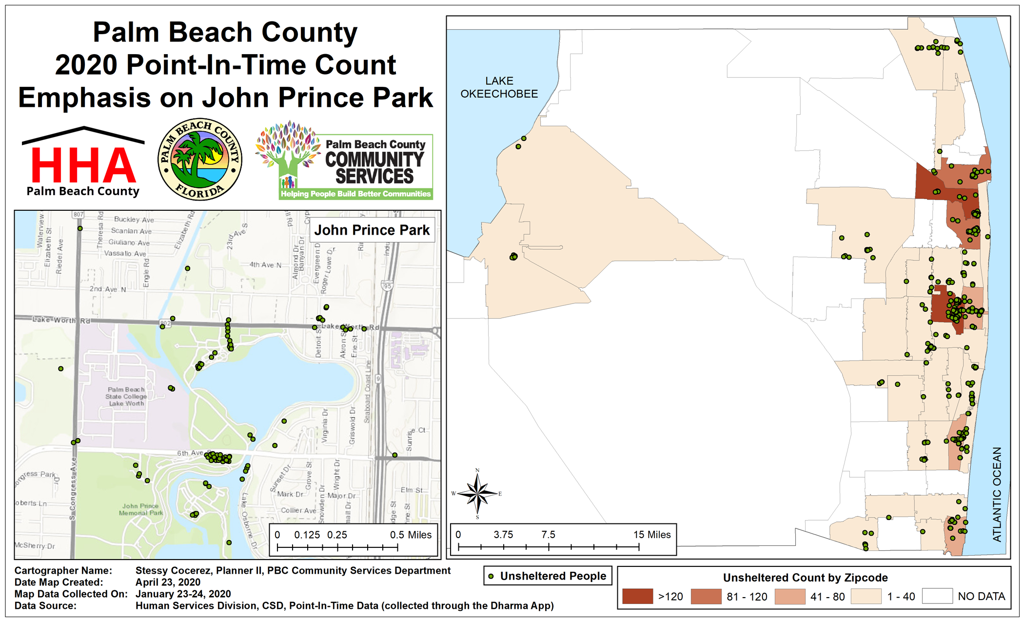
There were 110 unsheltered individuals counted in John Prince Park during the PIT count.
As of 5/20/2020, the count is over 150.

Slide 11
2020 PIT Count – Shelters
This chart represents our partnered agencies who counted homeless people in their shelters on the night of the PIT Count.
A total of 480 persons were sheltered. 361 persons in Emergency Shelter and 119 persons in Transitional Housing.
Notes:
This chart represents our partnered agencies who counted homeless people in their shelters on the night of the PIT Count. 480 persons sheltered
361 persons in Emergency Shelter
119 persons in Transitional Housing

Slide 12
2020 PIT Count – Subpopulations
The graphs below shows how many people by subpopulations are experiencing homelessness.

Slide 13
2020 PIT Count– Race & Subpopulation
Sheltered/Unsheltered are broken down into Family/Individual, Family/Individual are broken down into Subpopulations – Vet, Senior, and Youth.
Notes:
Unsheltered/Sheltered are broken down into Family/Individual, Family/Individual are broken down into Subpopulations – Vet, Senior, and Youth

Slide 14
2020 PIT Count– Ethnicity & Subpopulation
Sheltered/Unsheltered are broken down into Family/Individual, Family/Individual are broken down into Subpopulations – Vet, Senior, and Youth
Notes:
Unsheltered/Sheltered are broken down into Family/Individual, Family/Individual are broken down into Subpopulations – Vet, Senior, and Youth

Slide 15
2020 PIT Count - Race
Unsheltered/Sheltered pie charts represents how many people were counted in the PIT Count by Race
Notes:
Unsheltered/Sheltered pie charts represents how many people were counted in the PIT Count by Race

Slide 16
2020 PIT Count - Ethnicity
Sheltered/Unsheltered pie charts represents how many people were counted in the PIT Count by Ethnicity
Notes:
Unsheltered/Sheltered pie charts represents how many people were counted in the PIT Count by Ethnicity

Slide 17
2020 PIT Count – Unsheltered – Gender Identity & Sexual Orientation
The chart below shows how may unsheltered homeless persons by Gender Identity and Sexual Orientation
Notes:
Interesting. Let’s add percentages instead of the actual number here (or both).

Slide 18
2020 PIT Count – Unsheltered - Age Range
The graph below shows the number of unsheltered persons experiencing homelessness by their reported age.
Notes:
Good slide but this looks inconsistent with the youth count in an earlier slide. Please advise

Slide 19
Special Populations 2017-2020
The bar graph shows how many persons experiencing homelessness in the special population categories (Veterans, Seniors, Youth, Chronic) within the last four PIT Counts.
Notes:
These should be compiled by groups not by years. In other words, I should see the veteran count for 2017-2020. Its easier to see the trends if its by groups.

Slide 20
2020 PIT Count - Unsheltered – Foster Care & Veteran
Unsheltered pie charts represents how many people were counted in the PIT Count by self identifying as being a Veteran or ever in Foster Care.
Notes:
Unsheltered pie charts represents how many people were counted in the PIT Count by self identifying as being a Veteran or ever in Foster Care.

Slide 21
2020 PIT Count - Unsheltered – Health Conditions
Unsheltered pie charts represents how many people were counted in the PIT Count by self identifying as having one or multiple Health Conditions
Notes:
Unsheltered pie charts represents how many people were counted in the PIT Count by self identifying as having one or multiple Health Conditions

Slide 22
2020 PIT Count - Unsheltered – Chronic Homeless
Chronic Homelessness – 12 consecutive months homeless or 4+ occasions totaling 12 months over a span of 3 years.
Notes:
Add percentage update language

Slide 23
2020 PIT Count - Unsheltered – Times Homeless
The graph below shows how many times a person stated they were homeless in the past three years.
Notes:
Add percentages change size

Slide 24
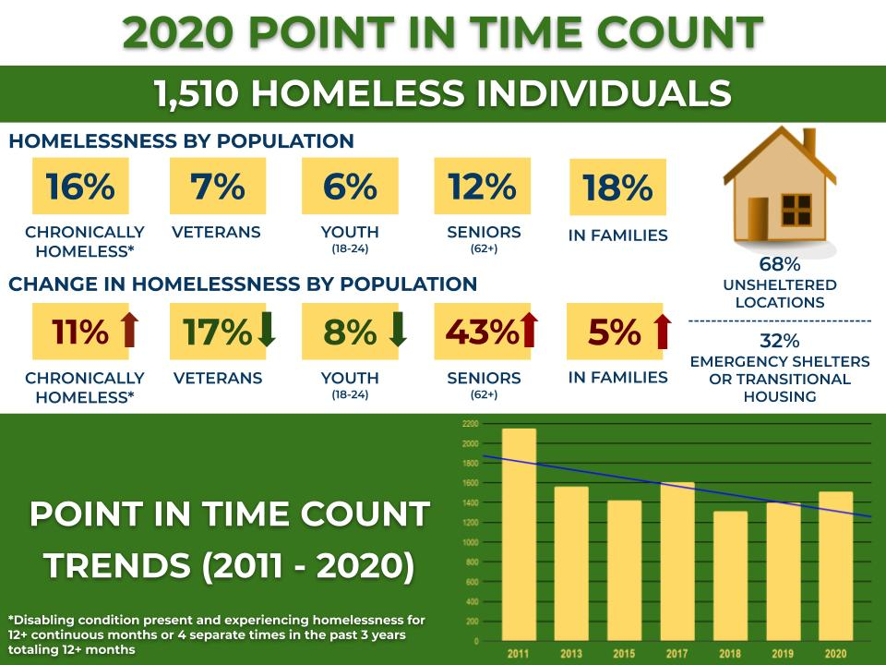
2020 Point-in-Time Count Infographic
Notes:
This should go towards the very end of the report.

